Slide 1





Data Preservation

Slide 2
V1: Introduction
The nature and importance of data preservation (first pass)
1

Slide 3
Preservation is an important part of curation
A central objective of curation:
efficiently and reliably support the analysis of data, and enable reuse over time
Despite:
Physical deterioration or damage to storage devices Decay of digital representations (bit rot)
Changes to file formats or encodings Changes to schemas and standards
Changes to software tools and applications
Loss or separation of critical contextual information or documentation
Changes in practices and expectations
and so on
(adapted from Giaretta, 2011)
2

Slide 4
A first definition
Digital preservation:
“… the active management of digital content over time to ensure ongoing access.” (US Library of Congress)

Slide 5
Obsolescence
File Format Obsolescence:
Software upgrades don’t support legacy files
Format is superseded by another or evolves in complexity File format is not compatible with current operating systems Company goes out of business or is bought by a competitor
Hardware/Media Obsolescence:
New, faster computers and storage media
Decrease in physical size of media (8in to 3.5in floppy disc) Reliability and fragility of media
Image from http://www.clir.org/pubs/reports/pub121/sec1.html

Slide 6
Physical Threats
Digital media and hardware are subject to numerous threats that can damage or destroy their readability:
Environmental (temperature, humidity, light, dust, dirt) Natural disaster (flood, earthquake)
Building failure (plumbing, electrical)
Inevitable hardware failure Human error or improper handling Sabotage (theft, vandalism)

Slide 7
Context
Examples of metadata that must not be lost:
File format:
Is this ASCII or EBCDIC?
Is this TEI version 2.1 or version 5.0?
Data context
Who collected this observations? Where? When? How? What do these attributes and values mean?
How were these values calculated?
Processing
What software created this file?
What software can read and process (render, perform, etc.) this?

Slide 8
V2: What is data preservation?
The common definitions are misleading
The problem: What exactly is preserved?
Our answer: Nothing is preserved
Our definition: [you’ll see] Why the definition is important
0

Slide 9
Some common definitions of data preservation
Preservation:
“. . . The professional discipline of protecting materials by minimizing chemical and physical deterioration and damage to minimize the loss of information and to extend the life of cultural property . . . “
(Society of American Archivists)
Digital preservation:
“… the active management of digital content over time to ensure ongoing access.” (US Library of Congress)

Slide 10
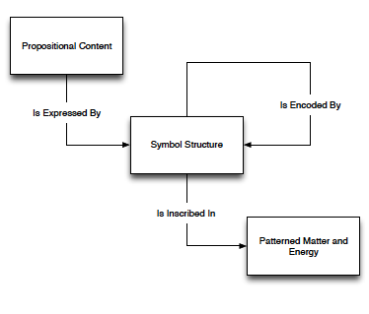
Recall our data ontology
Now ask yourself:
In a successful preservation scenario, what exactly is preserved?
What . . . exactly . . . is . . . preserved?
No, really, what?
2

Slide 11
The physical thing?
Maybe things in the patterned matter & energy entity type?
That would be actual disks, thumbdrives, hard drives, raid arrays, etc.
Sure, we often do need to take care of these, absolutely
But over time preservation of data (or information) may be successful, even as the individual physical media disappear or become inoperable.
So the continuing existence and integrity of some physical object is not necessary for preservation.
3

Slide 12
Propositional Content?
Maybe things belonging Proposition Content entity type?
That would be that data or information itself.
e.g., observations, claims, assertions, “facts” etc.
But do those things really need preservation?
Consider this assertion:
100,000 people live in zip code area 61820
Why does its “preservation” require our intervention?? (it can’t crumble, oxidize, dissolve, mold, etc.)
Such things cannot decay, and so cannot be the object of preservation
(at least not in the original and narrow sense of preservation).
4

Slide 13
Symbol Structures?
Maybe things of the Symbol Structure entity type?
But symbol structures also don’t need preservation consider: up:Z61820 cb:population “100000”
this is a repeatable sequence of tokens (or characters)
it also cannot oxidize fall apart, dissolve, get moldy, etc
And so it also does not need our help surviving the vicissitudes of nature.
[And in any case:
we often support preservation of data by deliberately changing symbol structures;
e.g., replacing an obsolete language or format with a different or newer one. ]
5

Slide 14
But if those things then . . . ?
So what is preserved?
We just observed that it can’t be any of the things in our data ontology!
The answer is:
Nothing is preserved.
Or perhaps less paradoxically:
No thing is preserved.
.
6

Slide 15
Data preservation is not about preserving data
Preserving physical objects (in the traditional sense of preservation) is part of data preservation, but only part.
Preservation of physical media must occur for some intervals of time, but data preservation can also take place even when particular media decay — and, indeed, often we deliberately discard media as part of a data preservation strategy.
Preserving propositions (assertions etc) and symbol structures (encodings) is not part of data preservation all: because they cannot decay.
And, moreover, their continued existence does not ensure preservation.
7

Slide 16
Preservation is not about preserving any thing
Data preservation is not about preserving the existence of objects
It is about communication with the future. [1] The best simple definition is
Ensuring reliable communication with the future [2]
[1] Reagan Moore, Towards a theory of digital preservation, The International Journal of Digital Curation, 2008
[2] Simone Sacchi, What do we mean by preserving digital information'? Towards sound conceptual foundations for digital stewardship (Doctoral dissertation, University of Illinois at Urbana Champaign), 2015.
8

Slide 17
The definition expanded. . .
Preservation is not about preservation.
Preservation is ensuring reliable communication with the future
More exactly: preservation actions are intended to ensure that future researchers (or other users*)
will come into possession of physical media and encodings
from which they will correctly recognize the originally intended propositional content
and from which they will be justified in believing that this propositional content is in fact the intended propositional content
* this can be adapted to more explicitly accommodate software agents and automatic processing. The key thing is that the process is reliable: all interpretations are (1) correct and (2) justified.
9

Slide 18
Why is this important?
Because when you emphasize that data preservation is:
Ensuring reliable communication with the future
You see that it is primarily about understanding and credibility,
not the physical persistence of objects
And that focuses our attention on preservation actions that ensure understanding and credibility, actions that are too often neglected.
10

Slide 19
Data Preservation

Slide 20
V3: The preservation⬄integration parallels
Preservation goals (again)
Preservation challenges appear isomorphic to integration challenges; tracing the parallels helps us to better understand
both the challenges and the required interventions.

Slide 21
Preservation goals
Many organizations and standards
have proposed classifications of preservation goals.
2

Slide 22
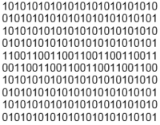
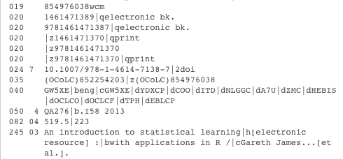
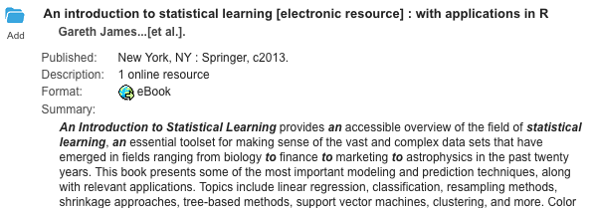
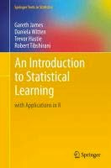
An early statement
Viable
(can be read from media)
Renderable
(viewable and processable)
Understandable
(interpretable)
See OCLC/RLG Working Group on Preservation Metadata. Image credits: UNC libraries.

Slide 23
And a longer one*
Viable
can be read (correctly) from media
Renderable
can be (correctly) viewed, processed, executed
Understandable
can be (correctly) understood
Authenticatable
can be (correctly) determined to be what it purports to be
Identifiable
can be (correctly) identified and re-identified
And more can be added of course: findable, conformant . . . etc..
Following our own definition of preservation we would emphasize that each of these five not only must be achievable,
but the user must have justified confidence in the result.
*See: PREMIS https://www.loc.gov/standards/premis/
4

Slide 24
The data integration⬄preservation isomorphism
In many respects the challenges of data preservation are the same as the challenges of data integration,
only across time rather than space
.
Let’s take a look at data preservation through that lens,
we will be able to apply many things we’ve already discussed.
(As always, metadata is a key instrument for achieving our objectives)
5

Slide 25
The role of physical media in communication with the future
Physical objects are essential for communication with the future — because we live in a world of space, time, energy, matter, and causality,
And so attending to those physical objects is necessary to ensure that communication.
But the individual objects involved need not persist throughout the entire temporal interval: Communication with the future is achieved via a chain of overlapping physical objects
Still, functionality of physical objects must be maintained during relevant intervals in the chain
.
Storage media, and associated hardware (drives, cables, etc.) must be protected against kinetic damage, chemical decay, electromagnetic insult, etc.,
as well as theft and loss.
For physical media the ensuring of communication is accomplished with policies and procedures,
the management of associated physical environments; accurate, complete, and computer readable documentation
[Associated digital objects (APIs, embedded systems, operating systems) must also be preserved.]
6

Slide 26
Communicating encoding
The decoding of every level of encoding must be reliable.
From reading 1s and 0s off media, to mapping the bitstream to bytes then integers, then characters or other meaningful symbolic units.
[With UTF and Unicode some things are easier than they were, but nothing here can be taken for granted.]
As always we ensure the communication of encoding like we ensure all communication:
through documentation, particularly computer-processable metadata that uses standard vocabularies and a standard serialization syntax.
Usually the most important role of this metadata is to indicate the various data standards being used at different levels of encoding, or to indicate extensions, restrictions, subsetting, or other modifications of standards.

Slide 27
Communicating the syntax
A schema that identifies the structure of the data statements and documents the controlled vocabulary of attributes, identifiers, and values is essential.
This schema should be computer processable so it can be used to validate the structure of the data, to supply data types, and to configure processing tools and applications.
Here again we ensure communication through documentation, particularly computer-processable metadata that uses standard vocabularies and a standard serialization syntax.
And here too the most important role of this metadata is often to indicate the various data standards being used.

Slide 28
Communicating the propositions
This is what it is all about: Ensuring the reliable communication of what is being asserted
All the prior attention given to media, encoding, and syntax helps. But there is more to do.
The constituents of propositions are relationships and entities indicated in the controlled vocabulary for the top level logical syntax. These must be identified, explained, documented.
For this a formal model or ontology is useful.
The schema for this ontology should be computer processable so it can be used for validation, data integration, and management of transformation to alternative syntaxes.
Again we are ensuring communication through documentation, particularly computer- processable metadata with standard vocabularies and standard serialization syntax.
And here too the most important role of this metadata is often to indicate the various data standards being used (here standard ontologies, perhaps modified).
However at this level natural language prose will also be essential:
temperature? location? county? race? species?
. . . such things cannot be explained by formal language alone.

Slide 29
Turtles?
[No, not the RDF serialization language]
As with data integration documentation
there is also the regress problem for data preservation as well.
Metadata for data is itself data,
and must also be preserved . . .
and that will require, among other things, metadata for metadata
Where to stop is a practical matter.
And the foundation will be natural language prose.
This is another reason why existing shared standards are so important.
They already back up mathematical formalities with natural language,
and their existence and use creates communities of shared understanding.
10

Slide 30
Data Preservation

Slide 31
V4: Standard preservation strategies
Here we review the four classic preservation strategies.
1

Slide 32
Four common strategies
Replication
Make lots of copies, distribute them widely
Migration
Keep updating your data to new formats, as needed
Emulation
Maintain software that emulates the original processing
Normalization
Convert data sets to a standard format optimized for preservation
2

Slide 33
Replication pitfalls
[Make lots of copies, distribute them widely]
Ensuring authenticity and identity across copies Storage costs are non-trivial, depending on
Scale of data
Independence of replications Number of replications
Each act of replication introduces room for the introduction of Errors
Confusion (same data?)
Particularly problematic for changes, slight or large, in encodings)
Most importantly replication does not protect data against technological changes that compromise the viability renderability, (etc) of formats.
3

Slide 34
Migration pitfalls
[Keep updating your data to new formats, as needed]
Every act of transformation introduces room for: Errors
Context loss Information loss
Migration is usually ad hoc,
taking place usually only when needed (e.g, new software tools); and often in an emergency -- when something critical fails
Migration and migration formats can be uncoordinated and unsystematic, leading sometimes to data sets in multiple poorly understood, lossy, over- specialized, and incompatible formats; and this can lead to confusion about compatibility, and scientific equivalence.
It does not reduce vulnerability to loss (as addressed by replication)
4

Slide 35
Emulation pitfalls
[Maintain software that emulates the original processing]
Highly expensive, highly complex
How do you identify the properties of any data set (program, etc.) that must be maintained (the significant properties).
For which audiences? Over the long term?
Not all significant properties can be emulated
Does not address the problems addressed by replication or migration (costs mounting!)
Emulation environments themselves may need to be preserved in turn
5

Slide 36
Normalization
[Convert data sets to a standard format optimized for preservation]
Here data sets are maintained in a format with standard encodings, syntax, and ontology, and full documentation at all levels.
For simple data sets this may be just documented CSV files.
For more complex data sets XML is commonly used, along with documentation of both syntax and ontology.
OWL and RDF with corresponding serializations are also used.
Data sets in new or specialized formats can be generated as needed
And often a suite of tools for transformations to other syntaxes or ontologies is maintained.
6

Slide 37
Normalization pitfalls
[Convert data sets to a standard format optimized for preservation]
Some central coordination and support may be required, or at least a rich culture of open development
Basic protection against loss still required.
Normalization vs Migration
Aspects of normalization (the role of transformations) are similar to migration, but migration (as a preservation strategy) can be distinguished from normalization
Migration creates a chain of data sets with the same data in different formats; Normalization is a hub and spokes model
We have said that migration formats are ad hoc, uncoordinated, often lossy and over specialized; and can lead to compatibility problems
But perhaps migration is better integrated into the practical reality of creating new formats for existing data than strategies that require transformation in and out of a single core format. (perhaps, but . . .).
7

Slide 38
Transformations
Both migration and normalization strategies involve transforming a data set in one format to a data set in another format,
both presumably with the same information.
Ideally the transformation, as well as the resulting data set, should be documented in a standard computer-processable metadata languages.
Regardless of whether this is a migration scenario or normalization scenario The next slide indicates one way this could happen.
[This is also an example of workflow and provenance documentation.]
8

Slide 39
Example of transformation documentation (very liberally modified from UIUC Medusa record by T. Habing)
<event version="2.1">
<eventIdentifier>
<eventIdentifierType>LOCAL</eventIdentifierType>
<eventIdentifierValue>MEDUSA:b21248fa-75ac-4c45-aae3</eventIdentifierValue></eventIdentifier>
<eventType>MIGRATION</eventType> <eventDateTime>2011-05-03T10:15:32</eventDateTime>
<eventDetail> The contentdm_record_1.xml file was transformed into the mods_1.xml file using XSLT. </eventDetail>
<linkingAgentIdentifier>
<linkingAgentIdentifierType>UIUC_NETID</linkingAgentIdentifierType>
<linkingAgentIdentifierValue>UIUC\gnibaht</linkingAgentIdentifierValue></linkingAgentIdentifier>
<linkingAgentIdentifier>
<linkingAgentIdentifierType>FILENAME</linkingAgentIdentifierType>
<agentIdentifierValue> contentDM_to_MODSv32.xsl </agentIdentifierValue></linkingAgentIdentifier>
<linkingObjectIdentifier>
<linkingObjectIdentifierType>FILENAME</linkingObjectIdentifierType>
<linkingObjectIdentifierValue> mods_1.xml </linkingObjectIdentifierValue></linkingObjectIdentifier>
<linkingObjectIdentifier>
<linkingObjectIdentifierType>FILENAME</linkingObjectIdentifierType>
<linkingObjectIdentifierValue> contentdm_record_1.xml </linkingObjectIdentifierValue></linkingObjectIdentifier>
</event>...
<agent version="2.1"> . .
A reformatting recorded in computer processable documentation; here PREMIS XML.
The input and output files are in bold black, the XSL file that specifies the transformation is in red. Documented transformation can support both migration strategy and normalization.
To see how agent is used to represent software associated with a preservation event in this example (search "FIDO”) in https://www.loc.gov/standards/premis/v3/sample-records/PREMIS-3-example-1.xml
(The example is liberally modified from UIUC Medusa record)
9

Slide 40
Data Preservation

Slide 41
V5. Two data preservation standards
OAIS
PREMIS

Slide 42
OAIS
The Open Archival Information System (OAIS) is a model for data archives.*
It is documented in Reference Model for an Open Archival Information System (OAIS), Recommended Practice, CCSDS 650.0-M-2 Issue 2, June 2012. https://public.ccsds.org/Pubs/650x0m2.pdf
OAIS was developed by the Consultative Committee for Space Data Systems [CCSDS 650.0-B-2], originally for space agency data
but now the most influential high level data archiving standard.
It is very comprehensive, but also very high level, which means that it is a general framework
but not a specific set of rules, formats, techniques, etc.
Take a look: https://public.ccsds.org/Pubs/650x0m2.pdf
*“OAIS” also refers to archives themselves as well as the standard.
2

Slide 43
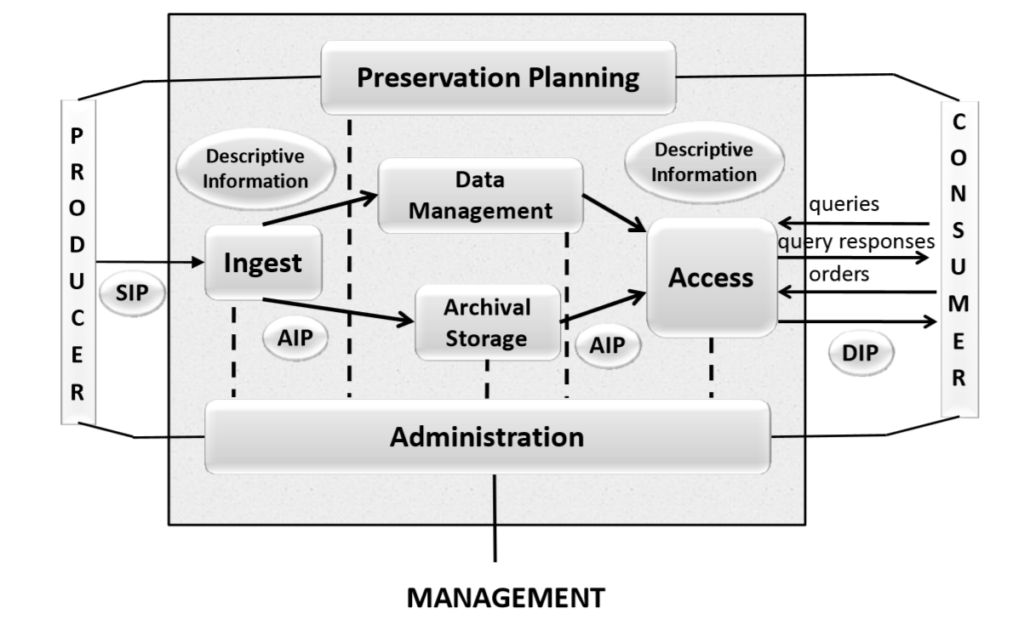
OAIS Functional Model
Section 4.1 – Oasis Functional Entities:
Reference Model for an Open Archival Information System (OAIS), Recommended Practice, CCSDS 650.0-M-2 (Magenta Book) Issue 2, June 2012

Slide 44



OAIS Information Package
Section 2.2 – OAIS Information Definition
Information Package Definition:
Content Information (Information Object)
Preservation Description Information
Reference
Provenance
Content Data Object
(Data Object)
Representation Information
Context
Fixity
Access Rights

Slide 45
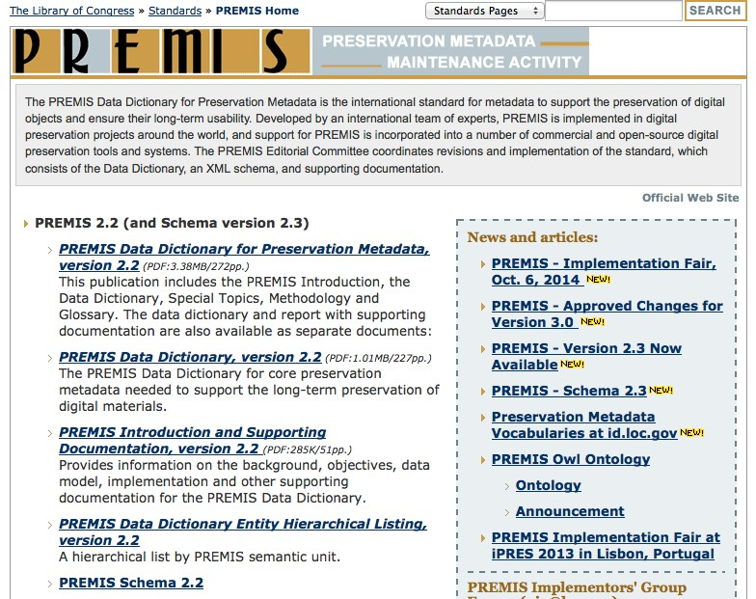
5

